Slide 1
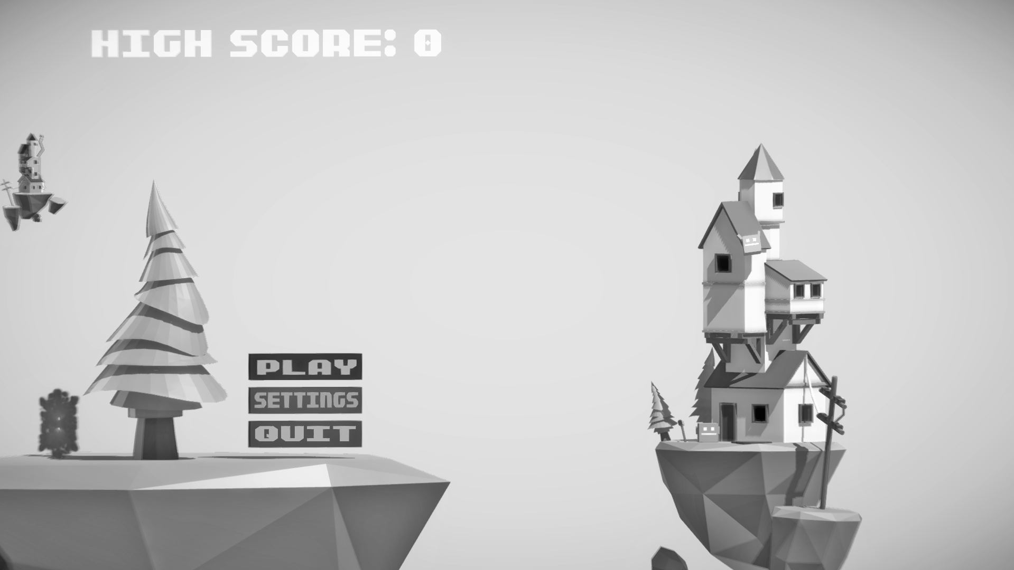

Uniscension
By:
Luke, Dan, Cameron, David, Kieran, Rofik
Notes:
Luke

Slide 2


Team roles
Luke
Dan
Cameron
David
Kieran
Rofik
– Team Leader / Programmer
– Programmer
– Joint-lead Designer / Artist
– Joint-lead Designer / Artist
– Designer / Artist
– Designer / Artist
Notes:
Kieran

Slide 3
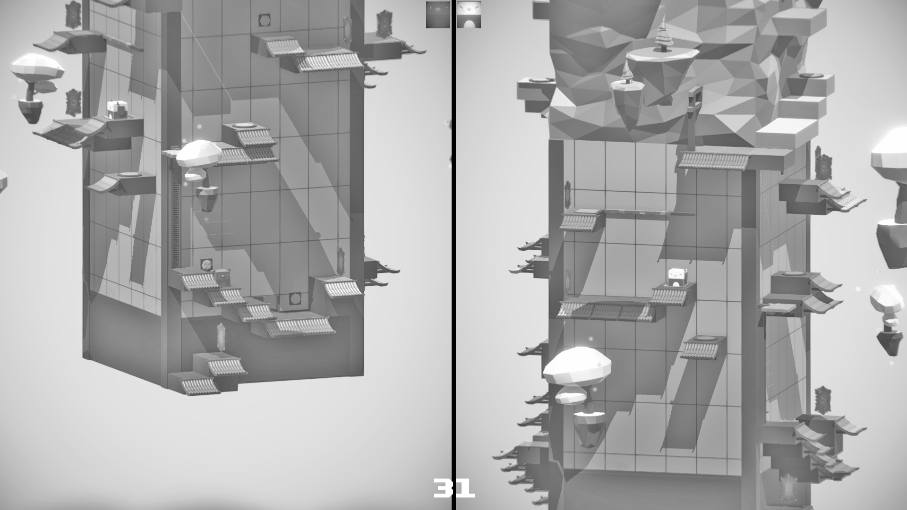
Why we picked this game (skillset, target audience etc...)
All the designers felt comfortable with the art style
Target audience: 7+ years
Notes:
Cameron

Slide 4
Concept References
Fez
Portal 2
Captain toad treasure tracker
Crossy Road
Kyub
Notes:
Keiran and Rofik

Slide 5
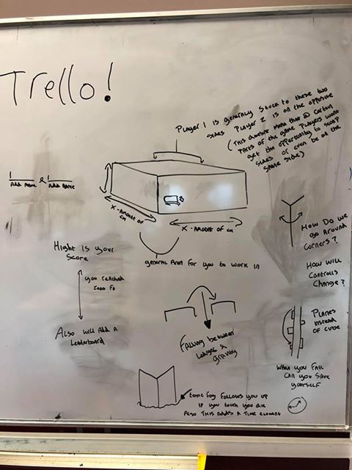
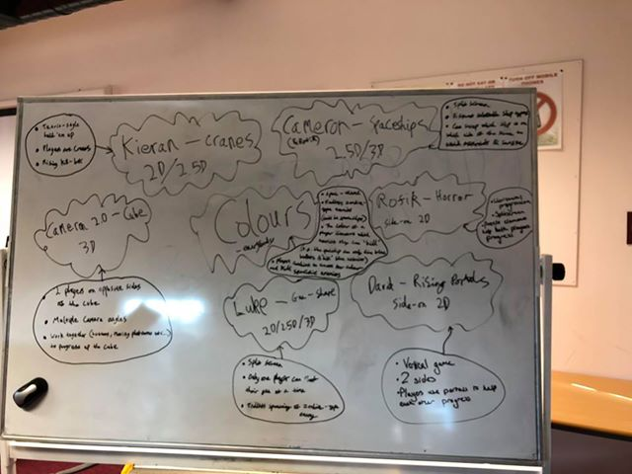
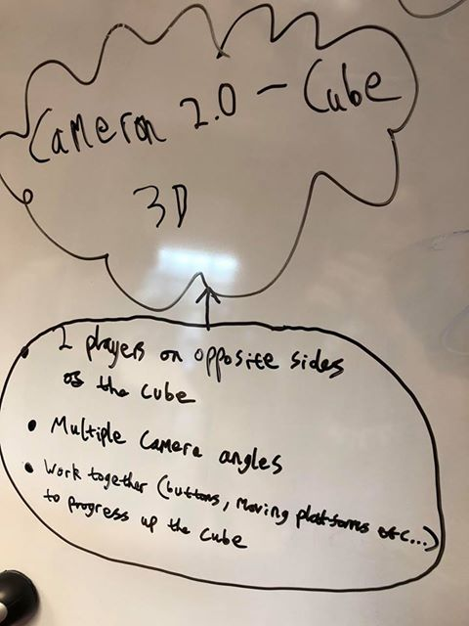
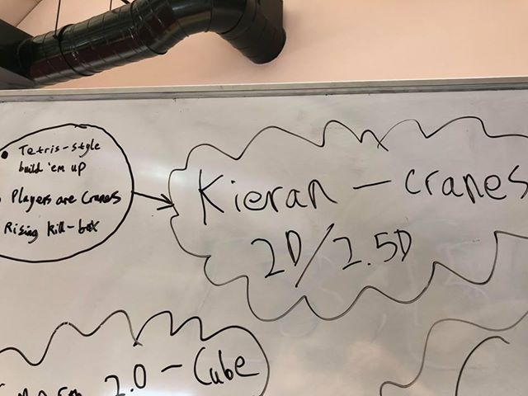
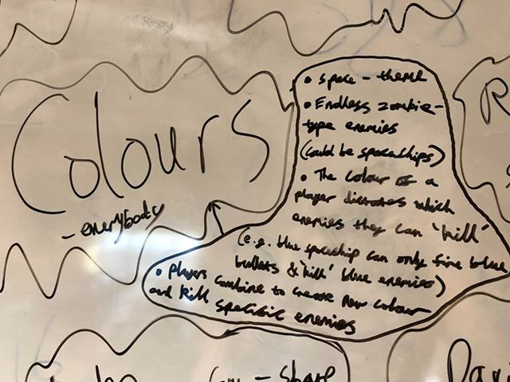
Concepts
Notes:
David (main speaker), all designers chipping in

Slide 6

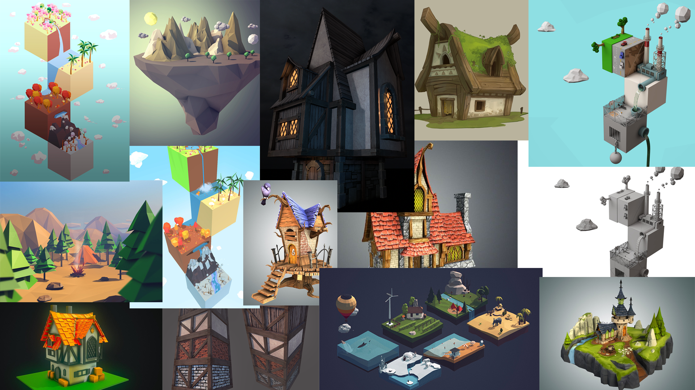
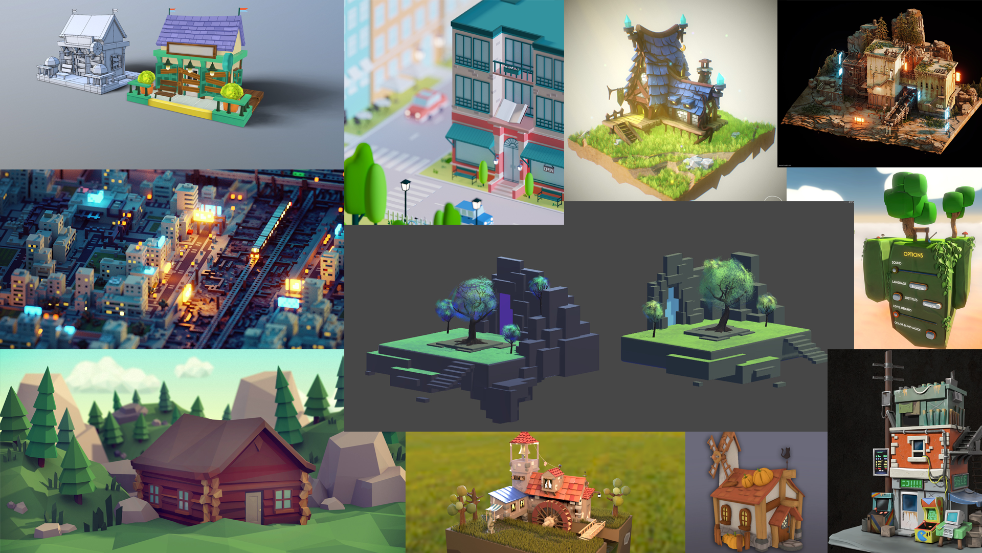

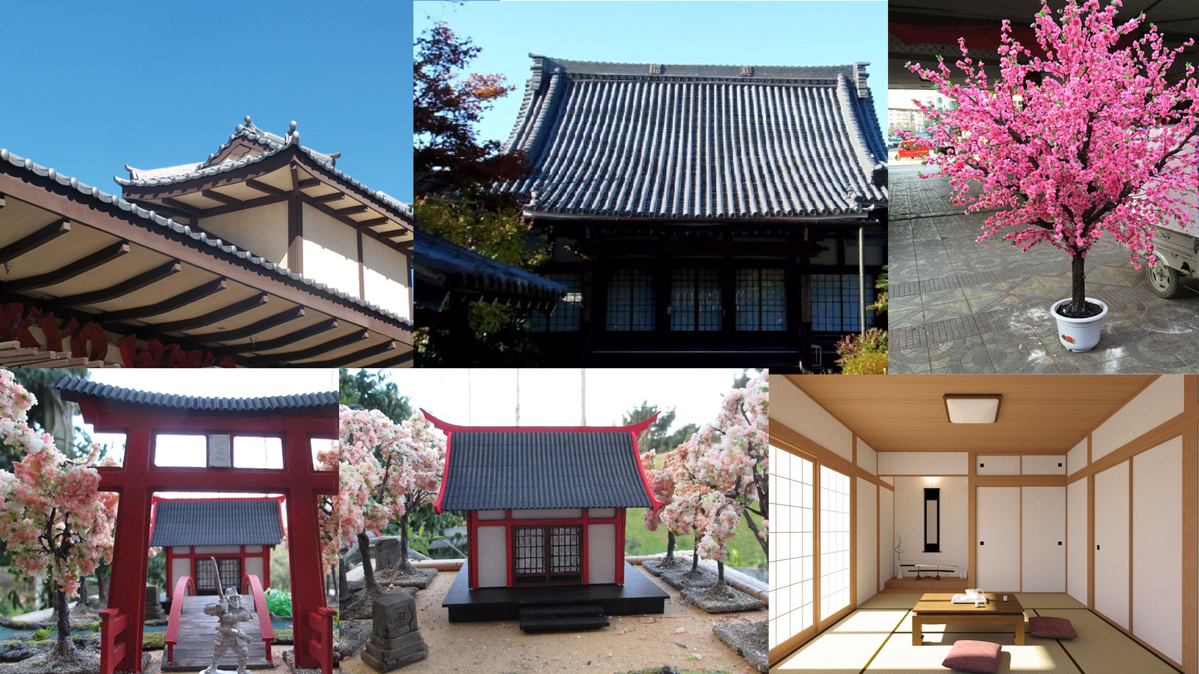
Notes:
David (main speaker), all designers chipping in

Slide 7
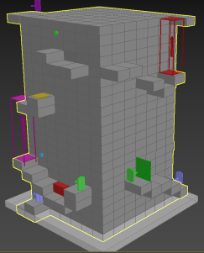
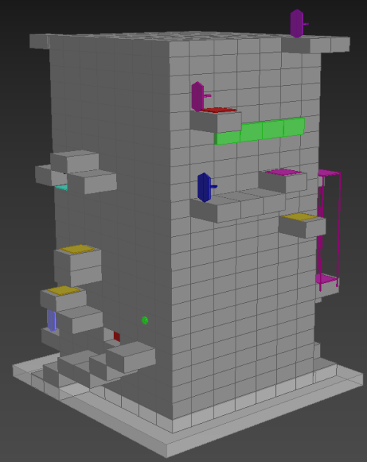
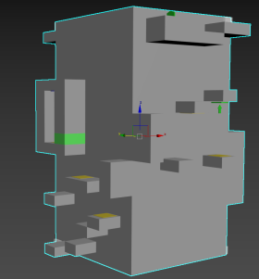
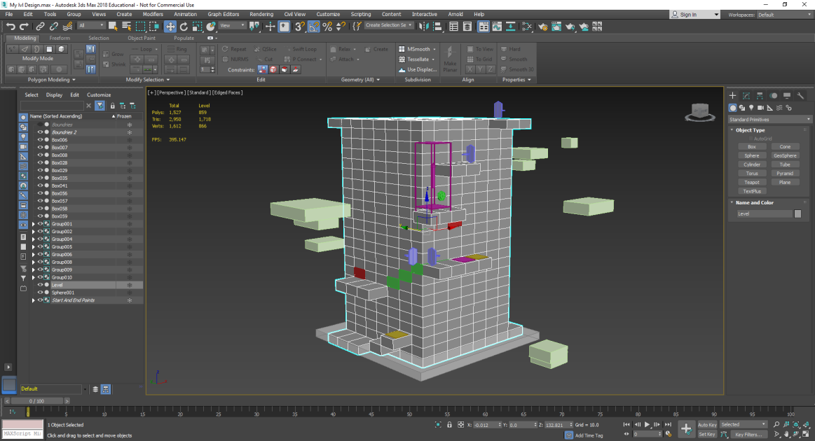
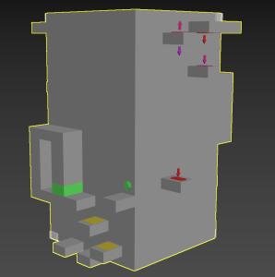
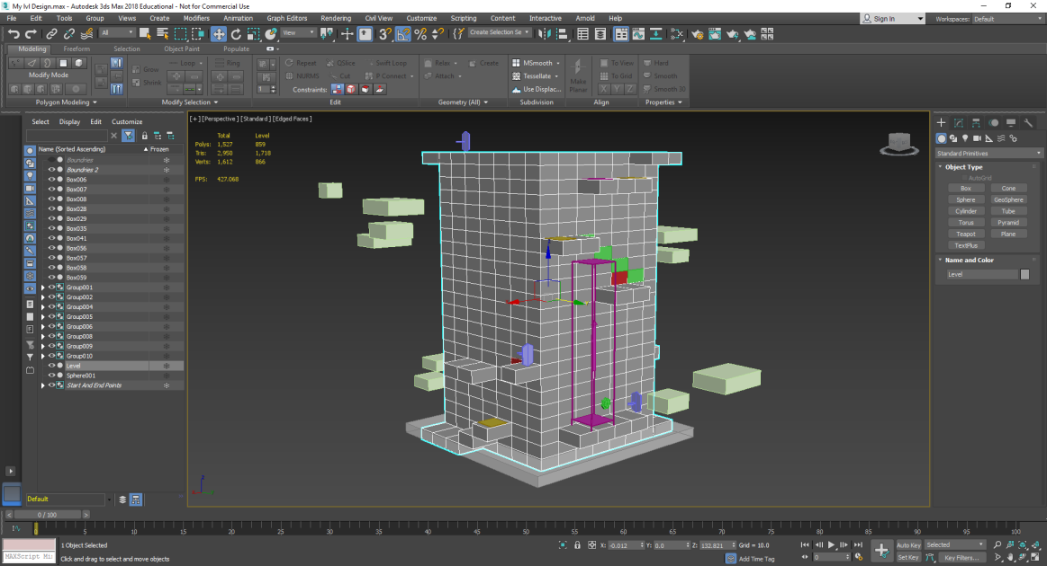
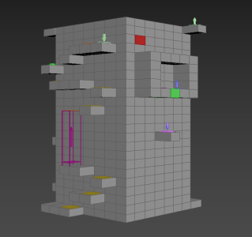
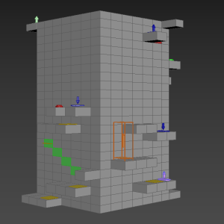
Notes:
David (main speaker), all designers chipping in

Slide 8
General planning
Initial meeting on Tuesday 23rd
We used meetings to make sure everyone was up to date
Tool choices decided in our first meeting on Monday
Notes:
Luke

Slide 9
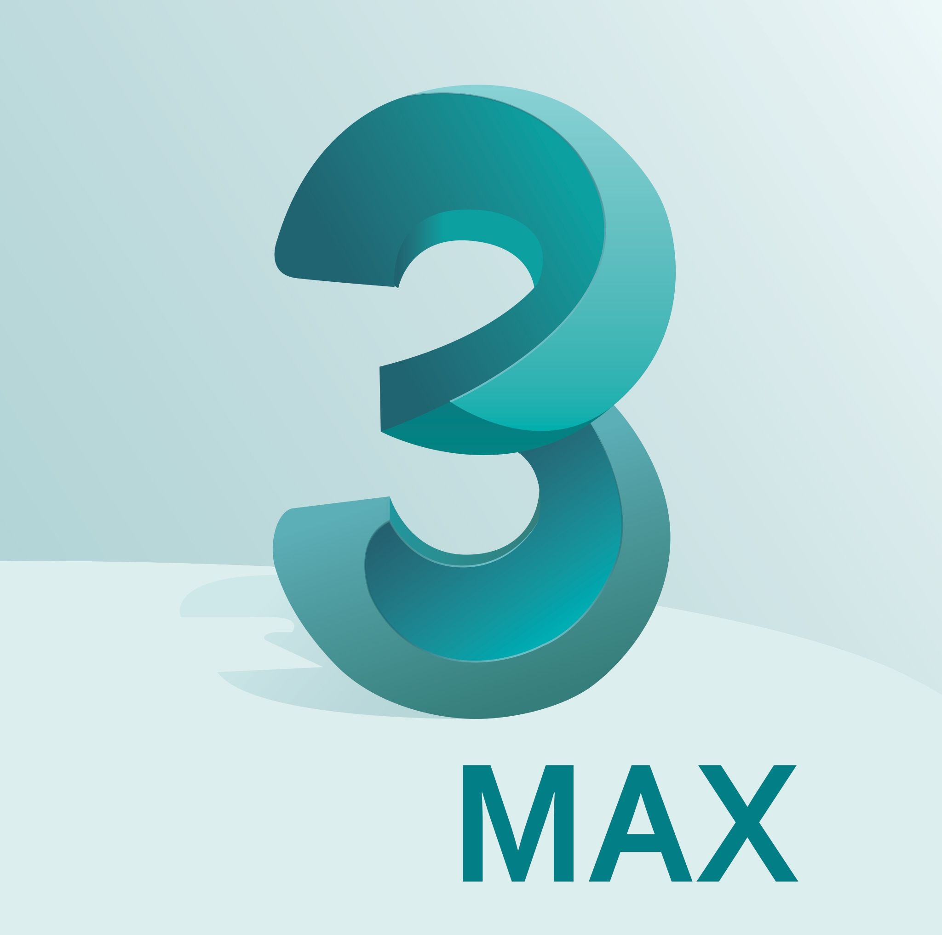


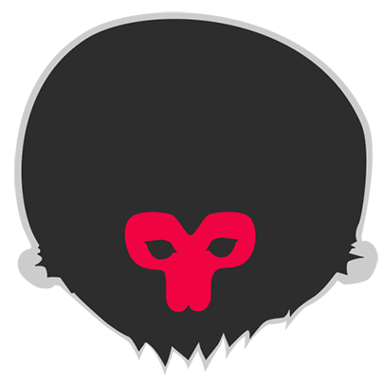






Software Used
Notes:
Rofik

Slide 10
Technical planning
Multiple entities with complex I/O links required
Generic interactable superclass to maintain good code structure, improve workflow & decrease work required to implement new levels
Implementation planning done before building solution
End result lead to easy and quick implementation of new elements, and quick setup & linking between objects
Codebase collaboration & merging done via github
Notes:
Dan

Slide 11
Design planning
Tools (3DS Max, Marmoset, Photoshop, ZBrush)
One modelled, unwrapped, textured level (plus floating islands) per designer
Those that finished their level first moved on to other assets
Floating islands (each level will include the main level where the player moves and several 'islands' which consist of props related to the levels theme rotate around it)
Notes:
Cameron

Slide 12
What went well (from a team work perspective)
The scope of the project
No arguments or clashing of personalities
Workflow was consistent and available to everyone
Notes:
Rofik

Slide 13
What went wrong (from a team work perspective)
Communication error (on Monday) resulting in two members of the team having a different perception of one of the core game mechanics (gravity behaving differently)
Some other, more minor communication issues (start and end position of modelled levels, designers should've set more specific guidelines for building puzzles)
Maybe didn’t use the ‘art bible’ enough (due to communicating over Discord instead)
Notes:
David

Slide 14
What we've learned from the process/What we'll do differently next time
How essential team-work is when building something of this size in the given time-scale
Next time, potentially three designers working on three levels, one designer working on the other assets
Complex puzzles where both players are interacting with the map at the same time so it can't all be done by one player with two controllers
UI could have been better designed
Notes:
Kieran

Slide 15
Demo
Notes:
Everyone

